Slide 1
Neural Networks
Melissa Anthony and Micah Reid

Slide 2
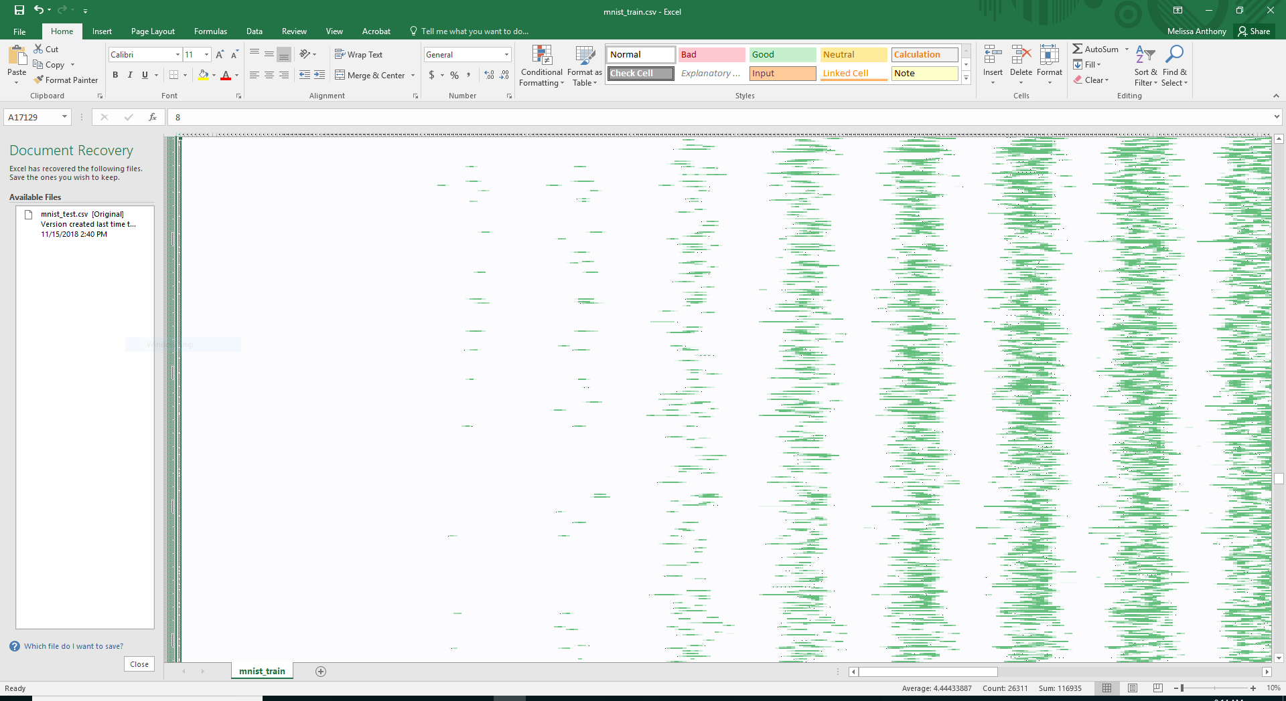
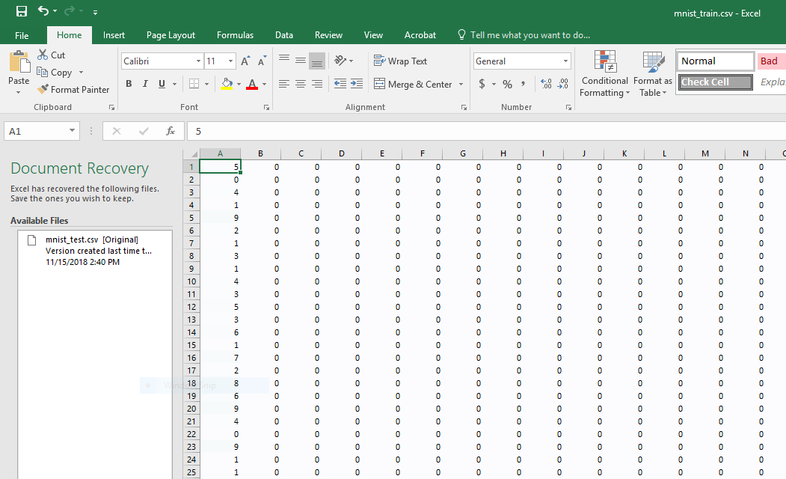
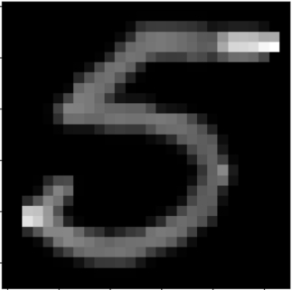
Notes:
Neural Networks are used for problems like pattern recognition. A classic problem for neural networks is recognizing handwritten numbers. Humans can tell that’s a 5 because our brains know what handwritten fives look like, but computers need neural networks based on the layers of neurons that human brains use for pattern recognition. To begin teaching the computer what a five, and a six, and all the other numbers look like, we first need a huge data set for training. It contains The pixels from the images of the handwritten numbers arranged in a list containing the brightness of the pixel. It’s mostly zeroes for empty space. On the spreadsheet on the left, you can see the number that was written, plus the beginning of the values representing the brightness of the pixels. On the spreadsheet on the right, you can see some of the vast amount of data we have, with the rows each being one handwritten letter and the columns being each pixel. You can see the darker cells that contain a larger number representing a pixel that isn’t blank.

Slide 3
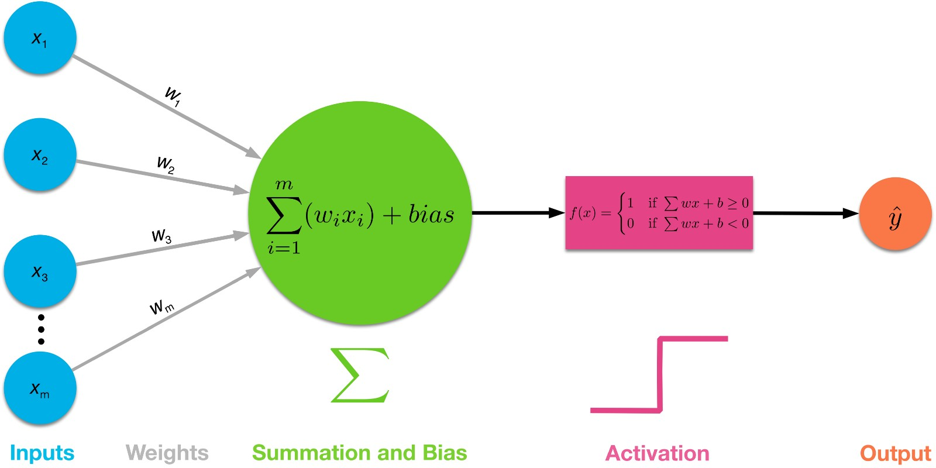
Notes:
Here we see several inputs to one node in a neural network. Each input is multiplied by the weight of the connection between the input and this node, and then the node sums all of those weights and adds it’s bias. Then, to determine the output of the node, it goes through an activation function. We used sigma, to give a probability, but this shows a binary activation function for a 1 or 0 output.

Slide 4
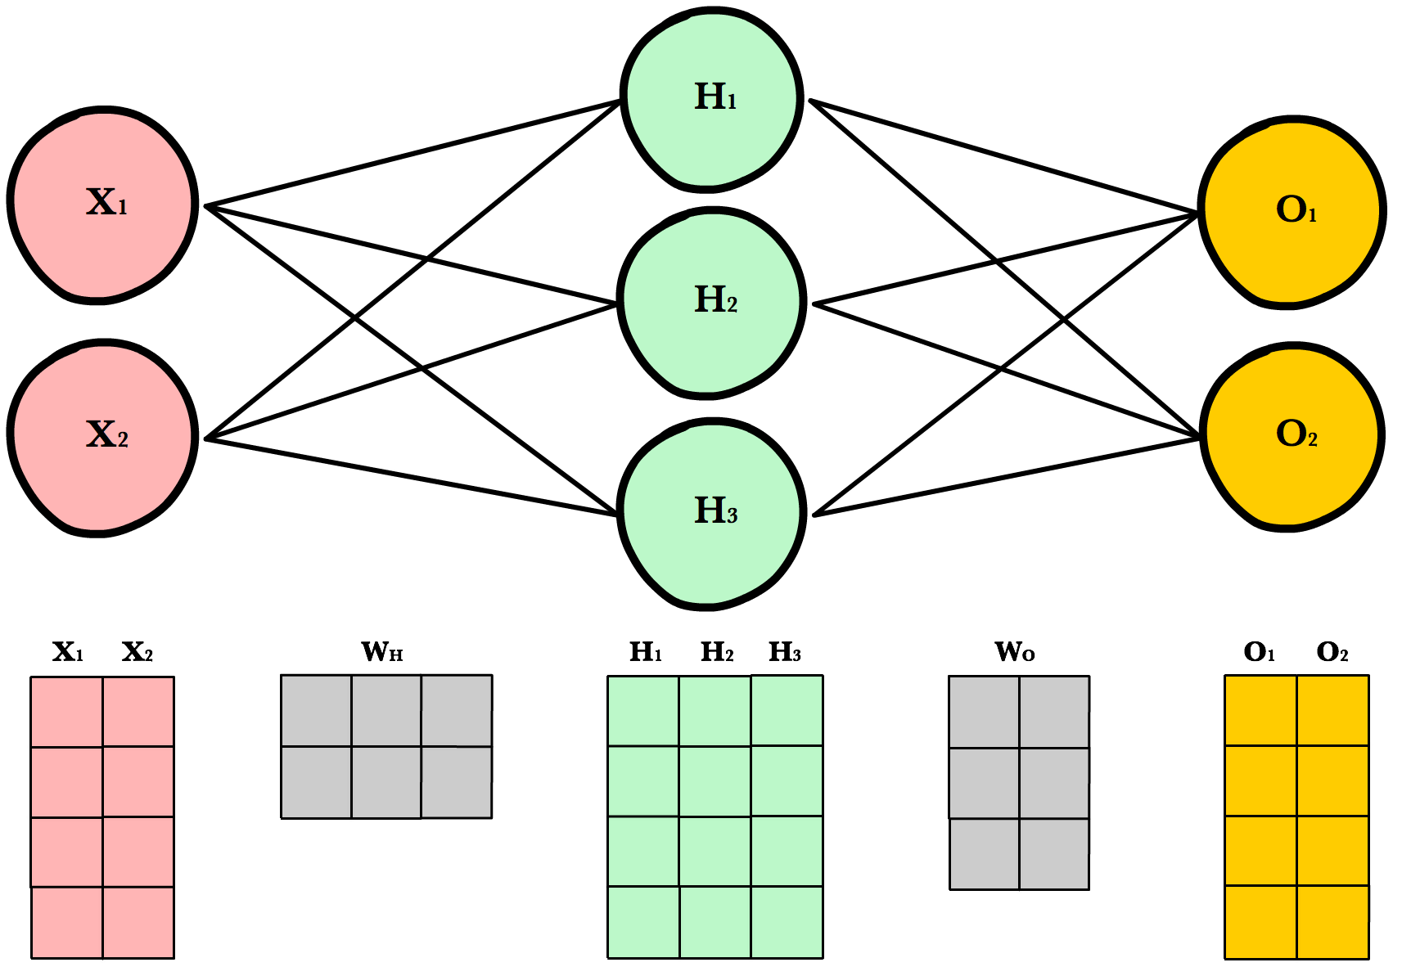
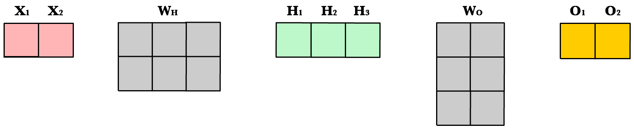
W₁₁
W₁₂
W₁₃
W₂₁
W₂₂
W₂₃
Notes:
When you input one data point, the input nodes are a 1 by 2 array, which gets multiplied by the 2 by 3 matrix that contains the weights to yield everything that gets passed into the hidden array.

Slide 6
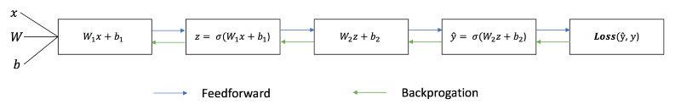

Slide 7

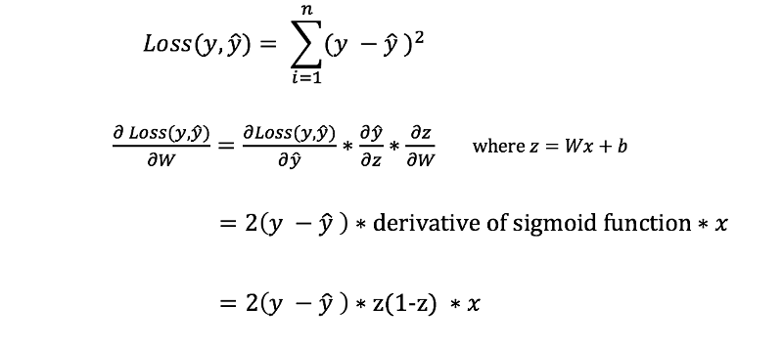

Slide 9
Results

Slide 10
Resources
Towardsdatascience.com article by James Loy:
https://towardsdatascience.com/how-to-build-your-own-neural-network-from-scratch-in-python-68998a08e4f6
FreeCodeCamp article by Daphne Cornelisse:
https://medium.freecodecamp.org/building-a-3-layer-neural-network-from-scratch-99239c4af5d3
Ava Lakmazaheri and Emily Lepert’s Linearity 2 Paper:
https://drive.google.com/file/d/1Z-xqGIVuRK9p1M4Qnov_orMx3R0ndbPq/view
3Blue1Brown Youtube Series on Neural Networks:
https://www.youtube.com/watch?v=aircAruvnKk
https://ml-cheatsheet.readthedocs.io/en/latest/forwardpropagation.html

